Slide 1
Natural Language Processing Summarization
Sudeshna Sarkar
17 Oct 2019

Slide 2



Overview
Extractive Summarization
Select phrases or sentences from the source document
Representation
sentence 1
1 | 3 | 9 | 2
sentence 2
5 | 6 | 5 | 7
sentence 3
8 | 1 | 1 | 4
…
Shen, D.; Sun, J.-T.; Li, H.; Yang, Q.; and Chen, Z. 2007. Document summarization using conditional random fields. IJCAI 2007.
Kågebäck, M., Mogren, O., Tahmasebi, N., & Dubhashi, D. Extractive Summarization using Continuous Vector Space Models. EACL 2014.
Cheng, J., and Lapata, M. Neural summarization by extracting sentences and words. ACL 2016.
Ramesh Nallapati, Feifei Zhai, and Bowen Zhou. Summarunner: A recurrent neural network based sequence model for extractive summarization of documents. AAAI 2017
Notes:
Earlier works focus on extractive summarization. Most of them perform sentence-level extraction.
They calculate sentence representations using handcraft features or learned from neural networks and then pick a few sentences as the summary.
While the extractive summarization can select important part of the article, it’s still not perfect since extractive summaries often contain redundant words.

Slide 3

Overview
Abstractive Summarization
Select phrases or sentences from the source document
Encoder
Article
Representations
Decoder
Alexander M Rush, Sumit Chopra, and Jason Weston. A neural attention model for abstractive sentence summarization. EMNLP 2015.
Ramesh Nallapati, Bowen Zhou, Cicero dos Santos, Caglar Gulcehre, and Bing Xiang. Abstractive text summarization using sequence-tosequence rnns and beyond. CoNLL 2016.
Abigail See, Peter J Liu, and Christopher D Manning. Get to the point: Summarization with pointergenerator networks. ACL 2017.
Romain Paulus, Caiming Xiong, and Richard Socher. A deep reinforced model for abstractive summarization. ICLR 2018.
Fan, Angela, David Grangier, and Michael Auli. Controllable abstractive summarization. arXiv preprint arXiv:1711.05217 (2017).
Notes:
With the advance of deep learning techiques, more and more research aims to generate abstractive summaries.
They use large paired data to train an encoder-decoder network.
This is a more challenging problem compared with extractive method.
But abstractive method provides a more flexible solution for summarization.
We can not only control the length but also style and content of the generated summaries.

Slide 4
Neural summarization (2015 - present)
Since 2015, there have been lots more developments!
Making it easier to copy
But also preventing too much copying!
Hierarchical / multi-level attention
More global / high-level content selection
Using Reinforcement Learning to directly maximize ROUGE, or other discrete goals (e.g. length)
Resurrecting pre-neural ideas (e.g. graph algorithms for content selection) and working them into neural systems
• …
List of summarization datasets, papers, and codebases: https://github.com/mathsyouth/awesome-text-summarization
A Survey on Neural Network-Based Summarization Methods, Dong, 2018 https://arxiv.org/pdf/1804.04589.pdf

Slide 5
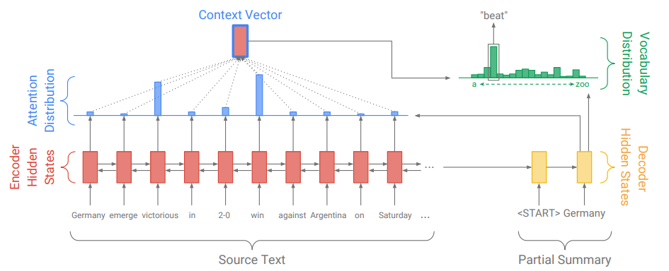
Abstractive Summarization: Sequence-to-sequence attentional model
Problems?
Out Of Vocabulary words

Slide 6
Neural summarization: copy mechanisms
Seq2seq+attention systems are good at writing fluent output, but bad at copying over details (like rare words) correctly
Copy mechanisms use attention to enable a seq2seq system to easily copy words and phrases from the input to the output
Clearly this is very useful for summarization
Allowing both copying and generating gives us a hybrid extractive/abstractive approach
There are several papers proposing copy mechanism variants such as
Language as a Latent Variable: Discrete Generative Models for Sentence Compression, Miao et al, 2016 https://arxiv.org/pdf/1609.07317.pdf
Abstractive Text Summarization using Sequence-to-sequence RNNs and Beyond, Nallapati et al, 2016 https://arxiv.org/pdf/1602.06023.pdf
Incorporating Copying Mechanism in Sequence-to-Sequence Learning, Gu et al, 2016 https://arxiv.org/pdf/1603.06393.pdf

Slide 7
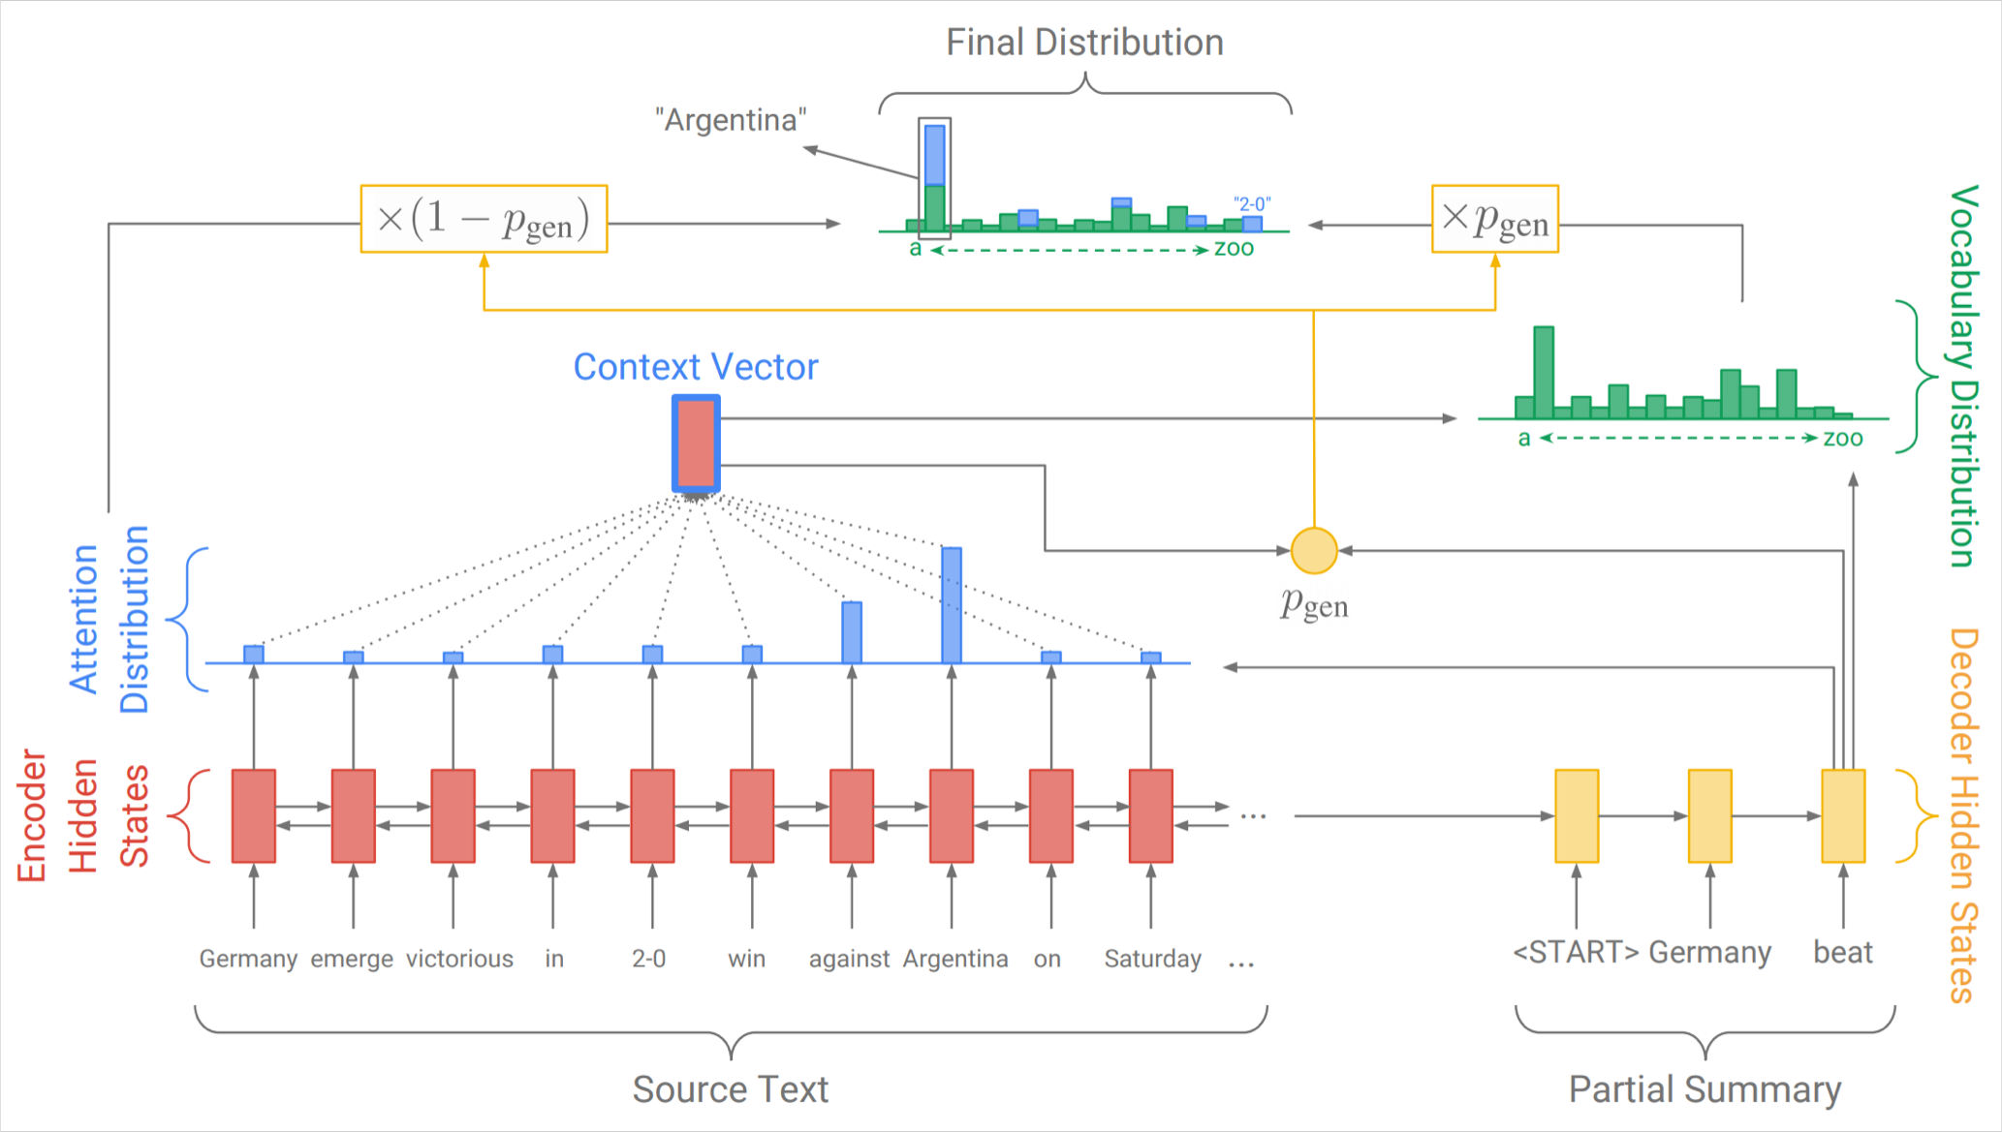
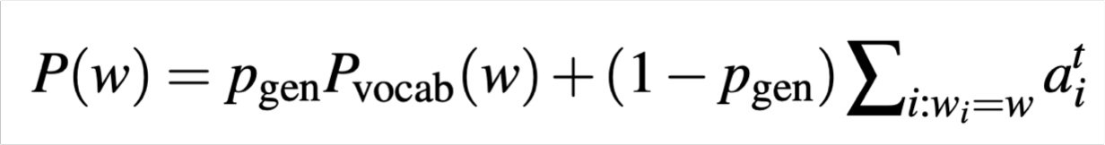
Neural summarization: copy mechanisms
One example of how to do a copying mechanism:
On each decoder step, calculate p_{gen}, the probability of generating the next word (rather than copying it). The final distribution is a mixture of the generation (aka “vocabulary”) distribution, and the copying (i.e. attention) distribution:
Get To The Point: Summarization with Pointer-Generator Networks, See et al, 2017 https://arxiv.org/pdf/1704.04368.pdf

Slide 8
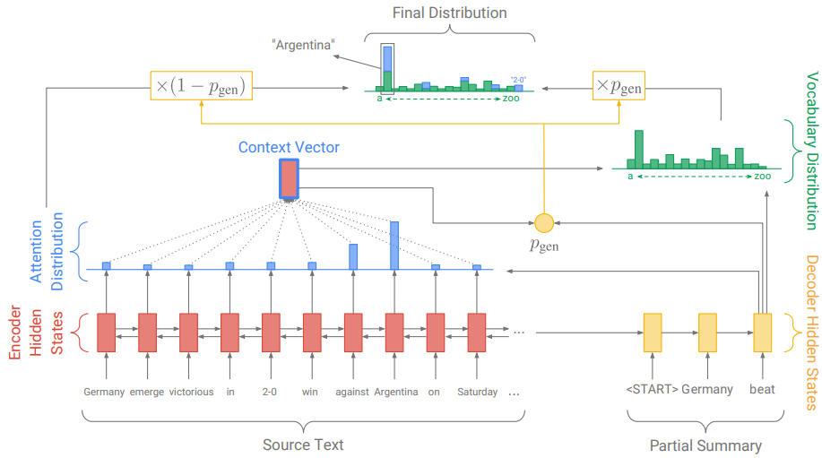

Slide 9




Coverage mechanism
To address the repetition issue.
Coverage vector c’
(sum of attention)
Additional input to attention
Inform attention network a reminder of its previous decisions.
Coverage loss
Final loss

Slide 10
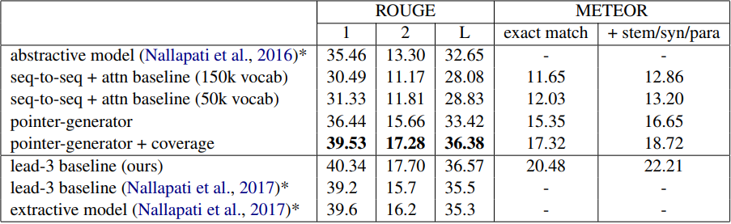
Results
* were trained and evaluated on the anonymized dataset
lead-3 baseline uses the first three sentences of the article as a summary.

Slide 11
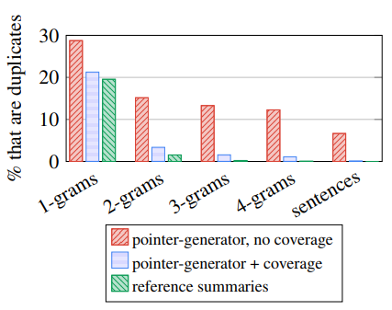
Results - Coverage
Coverage eliminates undesirable repetition.

Slide 12
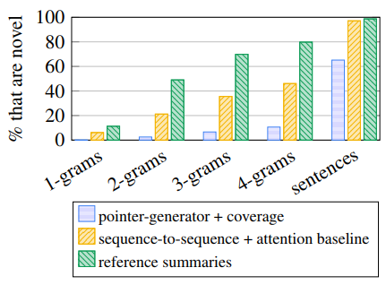
Results - Abstraction
The baseline mode produces more novel n-grams but mostly incorrect.

Slide 13
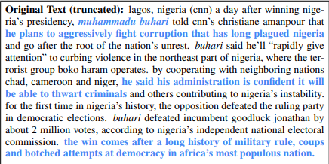
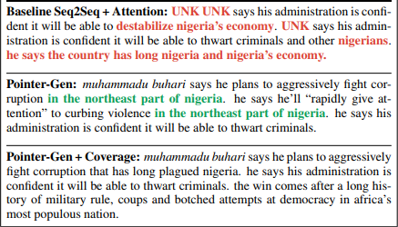
Results - Example
Baseline
Cannot generate OOV words (name).
Thwart -> destabilize
Repetition and eventually non-sense.

Slide 14
Neural summarization: copy mechanisms
Big problem with copying mechanisms:
They copy too much!
Mostly long phrases, sometimes even whole sentences
What should be an abstractive system collapses to a mostly extractive system.
Another problem:
They’re bad at overall content selection, especially if the input document is long
No overall strategy for selecting content

Slide 15
Neural summarization: better content selection
Recall: pre-neural summarization had separate stages for content selection and surface realization (i.e. text generation)
In a standard seq2seq+attention summarization system, these two stages are mixed in together
On each step of the decoder (i.e. surface realization), we do word-level content selection (attention)
This is bad: no global content selection strategy
One solution: bottom-up summarization

Slide 16
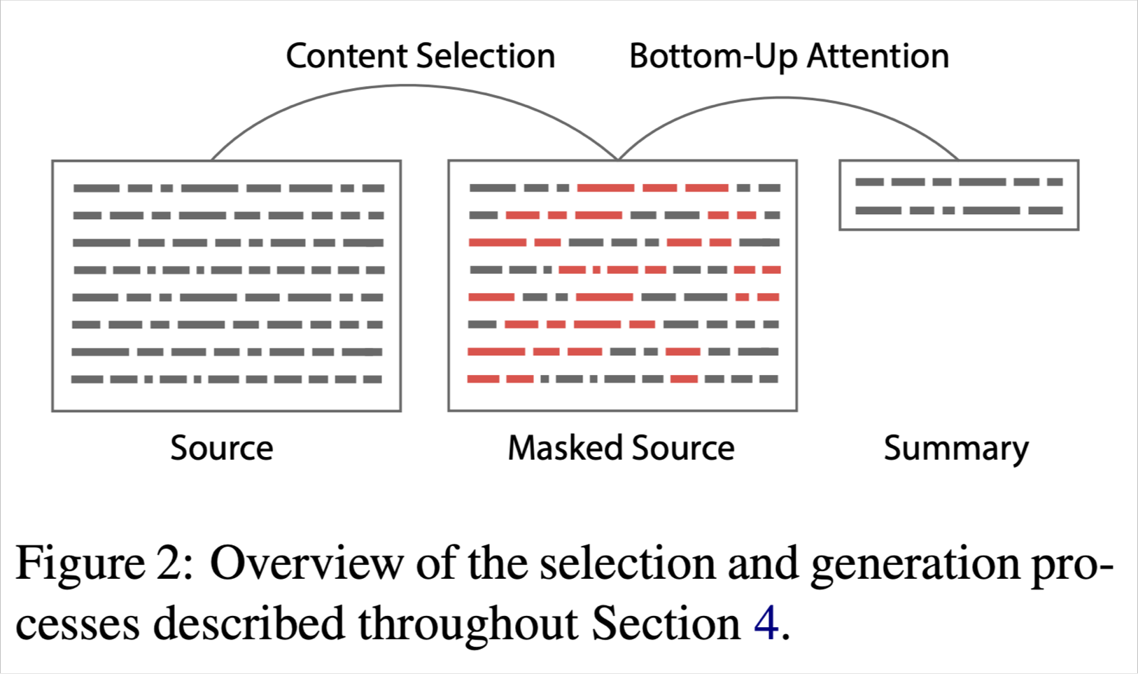
Bottom-up summarization
Content selection stage: Use a neural sequence-tagging model to tag words as include or don’t-include
Bottom-up attention stage: The seq2seq+attention system can’t attend to words tagged don’t-include (apply a mask)
Simple but effective!
Better overall content selection strategy
Less copying of long sequences (i.e. more abstractive output)
33
Bottom-Up Abstractive Summarization, Gehrmann et al, 2018 https://arxiv.org/pdf/1808.10792v1.pdf

Slide 17
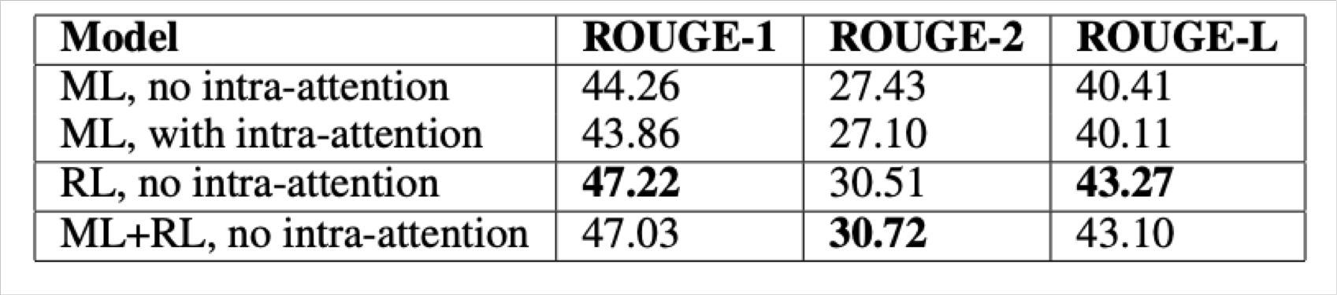
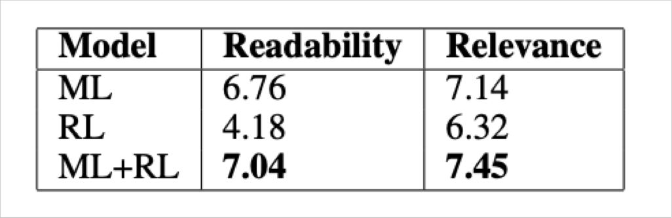
Neural summarization via Reinforcement Learning
In 2017 Paulus et al published a “deep reinforced” summarization model
Main idea: Use Reinforcement Learning (RL) to directly optimize ROUGE-L
By contrast, standard maximum likelihood (ML) training can’t directly optimize ROUGE-L because it’s a non-differentiable function
Interesting finding:
Using RL instead of ML achieved higher ROUGE scores, but lower human judgment scores
“We observed that our models with the highest ROUGE scores also generated barely- readable summaries.”
Overall, a hybrid approach does best!
A Deep Reinforced Model for Abstractive Summarization, Paulus et al, 2017 https://arxiv.org/pdf/1705.04304.pdf
34
Blog post: https://www.salesforce.com/products/einstein/ai-research/tl-dr-reinforced-model-abstractive-summarization/

Slide 18
Extractive Summarization
Most current systems
Use shallow analysis methods (frequent words)
Rather than full understanding
Work by sentence selection
Identify important sentences and piece them together to form a summary

Slide 19







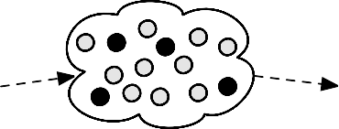




Summarization: Three Stages
content selection: choose sentences to extract from the document
information ordering: choose an order to place them in the summary
sentence realization: clean up the sentences
All sentences from documents
Extracted sentences
Sentence Realization
Summary
Document
Information Ordering
Sentence Segmentation
Sentence Extraction
Sentence Simpliﬁcation
Content Selection
Other operations: sentence fusion (multiple sentences are transformed into one sentence), compression (longer sentences are transformed into shorter ones), etc

Slide 20
Basic Summarization Algorithm (extractive)
content selection: choose sentences to extract from the document
information ordering: just use document order
sentence realization: keep original sentences
All sentences from documents
Extracted sentences
Sentence Realization
Summary
Document
Information Ordering
Sentence Segmentation
Sentence Extraction
Sentence Simpliﬁcation
Content Selection

Slide 21
Basic Summarization Algorithm (extractive)
content selection: choose sentences to extract from the document
information ordering: just use document order
sentence realization: keep original sentences
All sentences from documents
Extracted sentences
Sentence Realization
Summary
Document
Information Ordering
Sentence Segmentation
Sentence Extraction
Sentence Simpliﬁcation
Content Selection

Slide 22
Unsupervised content selection

Slide 23
Frequency as document topic proxy
Simple intuition, look only at the document(s)
Words that repeatedly appear in the document are likely to be related to the topic of the document (single document)
Sentences that repeatedly appear in different input documents represent themes in the input (multiple documents)
But what appears in other documents is also helpful in determining the topic
Background corpus probabilities/weights for word

Slide 24
What is an article about?
Word probability/frequency
Proposed by Luhn [Luhn 1958]
Frequent content words would be indicative of the topic of the article
In multi-document summarization, words or facts repeated in the input are more likely to appear in human summaries [Nenkova et al., 2006]

Slide 25
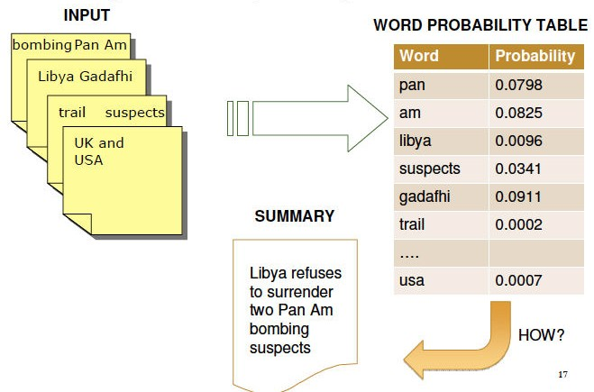

Slide 26
Main steps in sentence selection according to word probabilities
Step 1: estimate word weights (probabilities)
Step 2: estimate sentence weights
Step 3: choose best sentence
Step 4: update word weights
Step 5: go to step 2 if length not reached

Slide 27
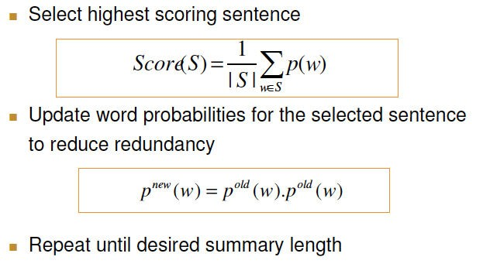

Slide 29
shortcomings of the pure frequency approaches
Does not take account of paraphrases or related words
bombing -- explosion
suspects -- trail
Gadhafi -- Libya
Does not take into account evidence from other documents
Function words: prepositions, articles, etc.
Domain words: “cell” in cell biology articles
Does not take into account many other aspects!
Semantic in general!

Slide 30
Salient words
H. P. Luhn. 1958. The Automatic Creation of Literature Abstracts. IBM Journal of Research and Development. 2:2, 159-165.
Intuition dating back to Luhn (1958):
Choose sentences that have salient or informative words
Two approaches to defining salient words
tf-idf: weigh each word w_{i} in document j by tf-idf
weight(w_{i} ) = tf_{ij} × idf_{i}
topic signature: choose a smaller set of salient words
log-likelihood ratio (LLR) test Dunning (1993), Lin and Hovy (2000)

Slide 31
Topic words (or topic signatures)
Which words in the input are most descriptive?
Instead of assigning probabilities or weights to all words, divide words into two classes: descriptive or not
For iterative sentence selection approach, the binary distinction is key to the advantage over frequency and TF*IDF

Slide 32
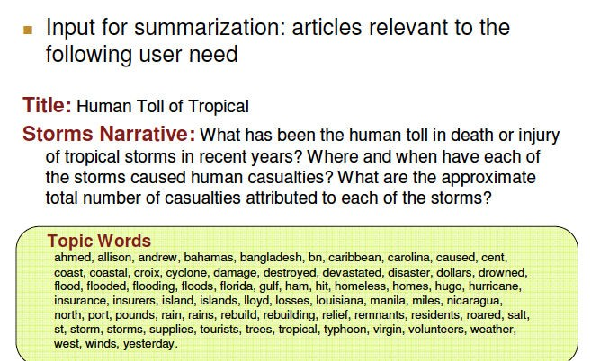
Example input and associated topic words

Slide 33
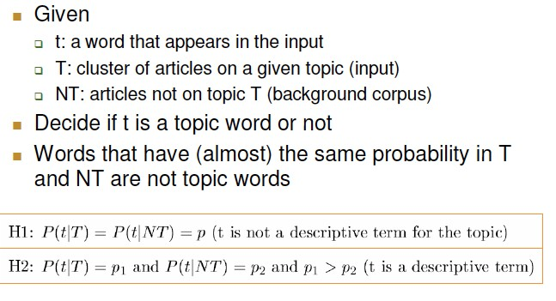
Formalizing the problem of identifying topic words

Slide 34
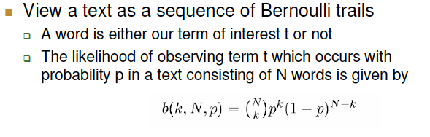
Computing probabilities

Slide 35
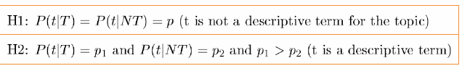

Testing which hypothesis is more likely:
log-likelihood ratio test

Slide 36
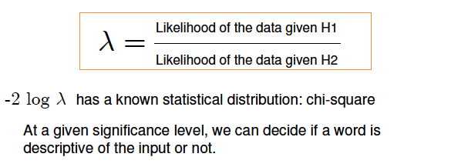
Testing which hypothesis is more likely:
log-likelihood ratio test

Slide 37
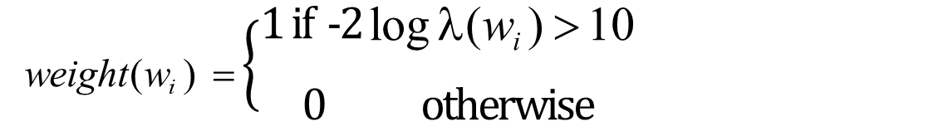
Unsupervised content selection
H. P. Luhn. 1958. The Automatic Creation of Literature Abstracts. IBM Journal of Research and Development. 2:2, 159-165
Topic signatures are assigned with weight of 1
weight(w_{i} ) = $\left\{\begin{matrix}1 if\text{ -}\text{2 }\text{l}\text{og} \text{λ}\text{(}\text{w}\text{i} \text{)} \text{>} \text{10} \\ 0 otherwise\end{matrix}\right.$
Confidence level at 0.001

Slide 38
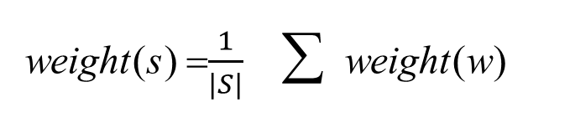
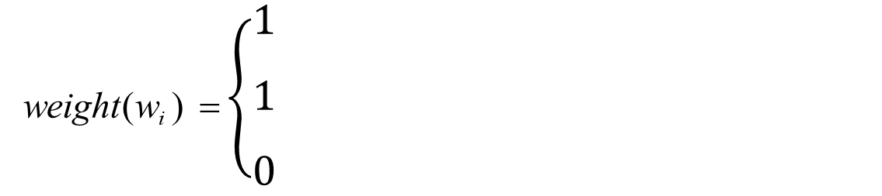
Topic signature-based content selection with queries
choose words that are informative either
by log-likelihood ratio (LLR) test
or by appearing in the query (if there is question)
Weigh a sentence (or window) by weight of its words:
if -2 log λ(w_{i} ) > 10 if w_{i} ∈ question otherwise
weight(w_{i} ) = $\left\{\begin{matrix}1 \\ 1 \\ 0\end{matrix}\right.$
weight(s) =$\frac{1}{|S|}$ ∑ weight(w)
w∈S

Slide 39
Supervised content selection
Given:
a labeled training set of good summaries for each document
Align:
the sentences in the document with sentences in the summary
Or ask human to select sentences
Extract features
position (first K sentence?)
length of sentence
word informativeness, cue phrases
Train
Problems:
hard to get labeled training data (sometimes only abstractive summaries are available)
alignment difficult
even the same person would select different sentences if she performs the task at different times
performance not better than unsupervised algorithms
So in practice:
Unsupervised content selection is more common
a binary classifier (put sentence in summary? yes or no)

Slide 40
Think: How to deal with redundancy?
Author JK Rowling has won her legal battle in a New York court to get an unofficial Harry Potter encyclopedia banned from publication.
A U.S. federal judge in Manhattan has sided with author J.K. Rowling and ruled against the publication of a Harry Potter encyclopedia created by a fan of the book series.

Slide 41
Information Ordering
In what order to present the selected sentences?
An article with permuted sentences will not be easy to understand
Very important for multi-document summarization
Sentences coming from different documents

Slide 42
Information Ordering
Chronological ordering:
Order sentences by the date of the document (for summarizing news) (Barzilay, Elhadad, and McKeown 2002)
Coherence:
Choose orderings that make neighboring sentences similar (by cosine).
Choose orderings in which neighboring sentences discuss the same entity (Barzilay and Lapata 2007)
Topical ordering
Learn the ordering of topics in the source documents

Slide 43
Automatic summary edits
Some expressions might not be appropriate in the new context
References:
he
Putin
Russian Prime Minister Vladimir Putin
Discourse connectives
However, moreover, subsequently
Requires more sophisticated NLP techniques

Slide 44
Before and After
Pinochet was placed under arrest in London Friday by British police acting on a warrant issued by a Spanish judge. Pinochet has immunity from prosecution in Chile as a senator-for-life under a new constitution that his government crafted. Pinochet was detained in the London clinic while recovering from back surgery.
Gen. Augusto Pinochet, the former Chilean dictator, was placed under arrest in London Friday by British police acting on a warrant issued by a Spanish judge. Pinochet has immunity from prosecution in Chile as a senator-for-life under a new constitution that his government crafted. Pinochet was detained in the London clinic while recovering from back surgery.

Slide 45
Knowledge-based and Advanced Systems
Discourse information -> coherent summaries
Use external lexical resources -> redundancy detection
Wordnet, adjective polarity lists, opinion
Using machine learning models -> neural network and reinforcement learning
Towards abstractive summarization

